Slide 1
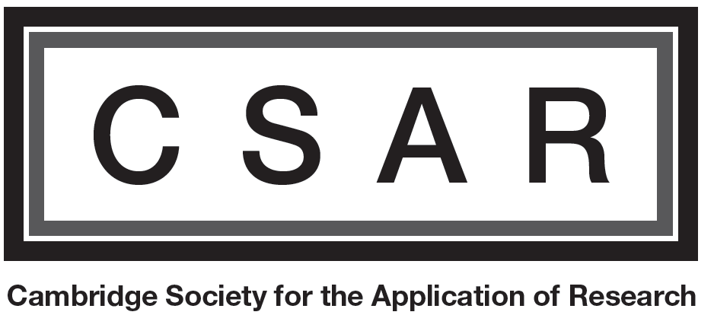
Post Brexit’s sterling Flash crash in perspective, how bad is it compared to 224 years of history?
17 October 2016
Alain Naef – St. Edmunds College

Slide 2
What is a flash crash?
The foreign exchange (FX) market is a monster
The equivalent of the endowment of the University of Cambridge is traded every 2 minutes
But when Europe sleeps, America goes to bed, and Asia still needs a coffee, there is less volume
Something went wrong and started a rational algorithm panic

Slide 3
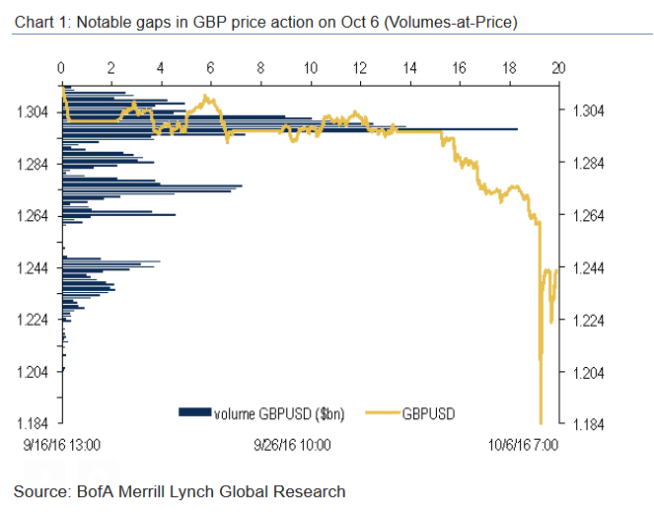
What happened 10 days ago?
Notes:
220 billion per hour
5.89 billion GBP
1.6*60 seconds trade of UCam endowment

Slide 4
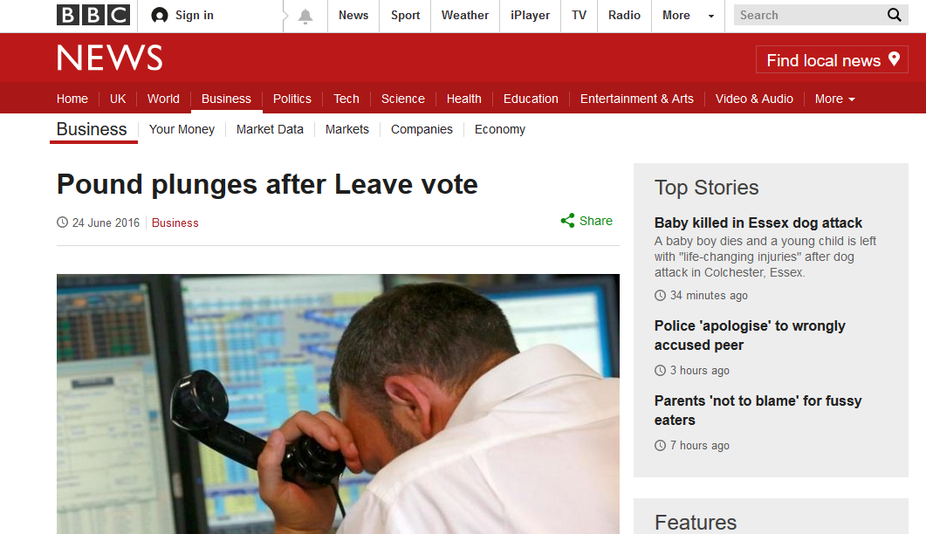
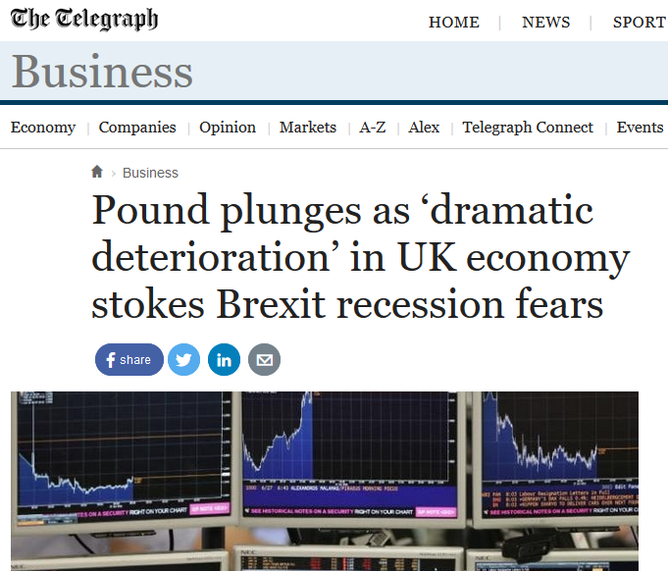
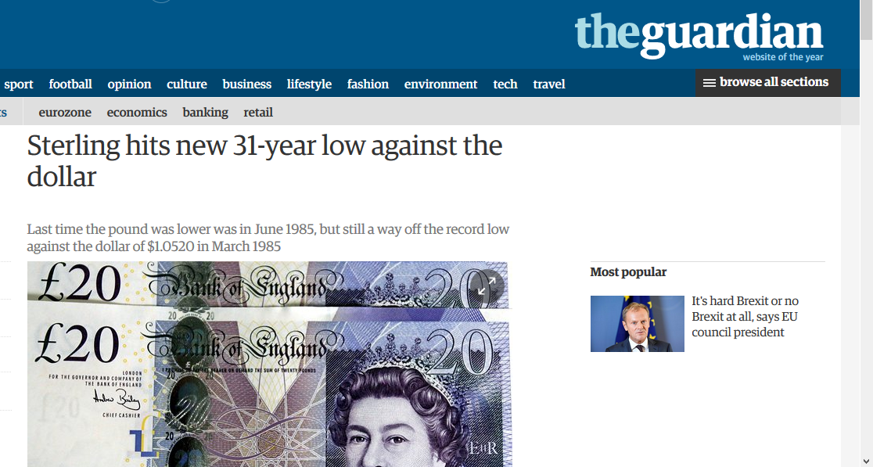
31-year low? What are the media getting wrong?

Slide 5
Historical comparisons
8 August 1914 | -6% | Britain declares war (Defence of the Realm Act)
21 September 1931 | -24% | Britain leaves the gold standard
25 August 1939 | -6% | Britain supports Poland before invasion
10 May 1940 | -10% | German invasion of France
19 September 1949 | -30% | Government initiated devaluation
16 September 1992 | -4% | Soros outsmarts the Bank of England
24 June 2016 | -8% | Brexit
6 October 2016 | -6% | Flash crash

Slide 6
How does this compared to two centuries of history?
Notes:
Only a US getting out of inflation story → strong dollar
Low sterling a natural thing and not essentially bad

Slide 7
Is that good or bad for the British economy?
Lower exchange rates and higher inflation expectations are great news, the Telegraph is right...
…and Mark Carney was probably hoping for these two things to happen since he took office
But….
…they are only symptoms of a weaker economy and will lead to inflation in a context of a low wages in a recovering economy
A bit if a doctor would tell a malaria patient with fever that he should be happy to feel warmer in this cold weather.

Slide 8
Questions?

