Slide 1
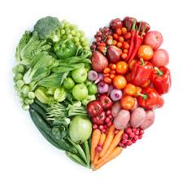

Addressing the challenges of feeding the world sustainably
Tim Benton
UK Champion for Global Food Security & Professor of Ecology, University of Leeds
tim.benton@foodsecurity.ac.uk
@timgbenton

Slide 2
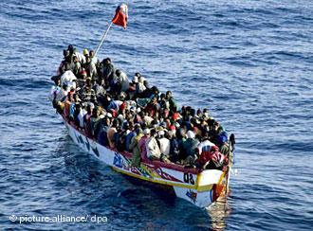
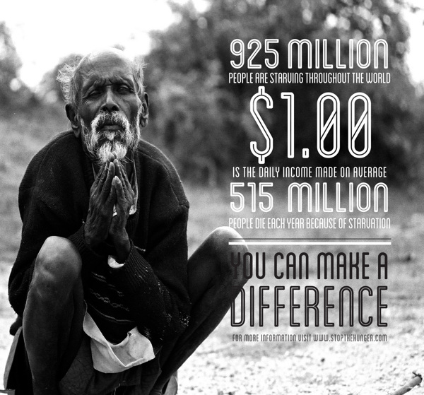
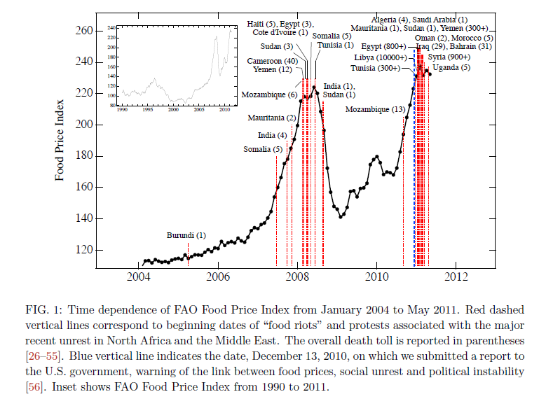
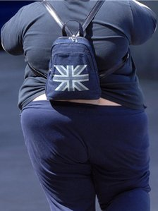
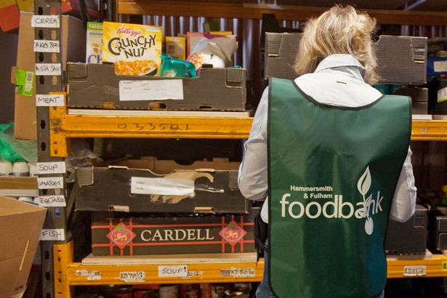
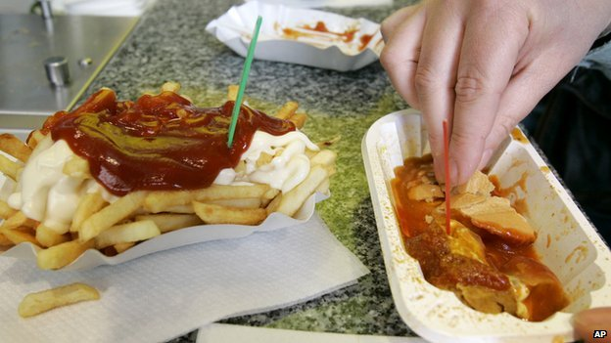
Food matters in many ways
Food security occurs when all people at all times have access to sufficient, safe and nutritious food that meets their dietary needs and preferences for an active and healthy life
…and agri-food accounts for more land-use than any other sector, more employment, and arguably, more pollution and more ill-health

Slide 3













Global Food Security Programme
“Food security, nutrition and sustainable agriculture must remain a priority on the political agenda, to be addressed through a cross-cutting and inclusive approach, relevant to all stakeholders at global, regional and national level.” [G8 statement July 2009]
Stakeholders in:
Academia
Industries
Civil Society
The Public
We foster a systems’ view across all major public funders of research
Notes:
3

Slide 4
the food system

Slide 5
waste
What is needed for the system to provide food security, sustainably?
Notes:
Consumers say the food companies
The food companies say the consumer
Govt stays out of it as long as the market more or less works
Consumers ultimately have the power but not the knowledge
How much does the food chain have a responsibility to drive things towards sustainability?

Slide 6
Why is food a worry?
Driver 1: Demand is growing

Slide 7
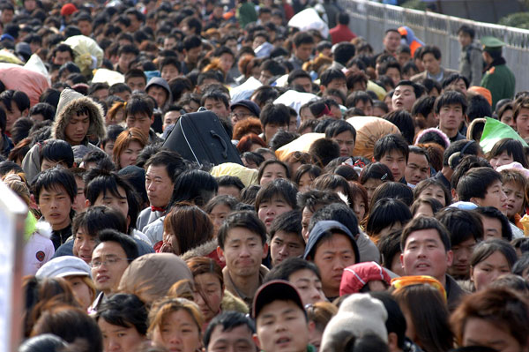
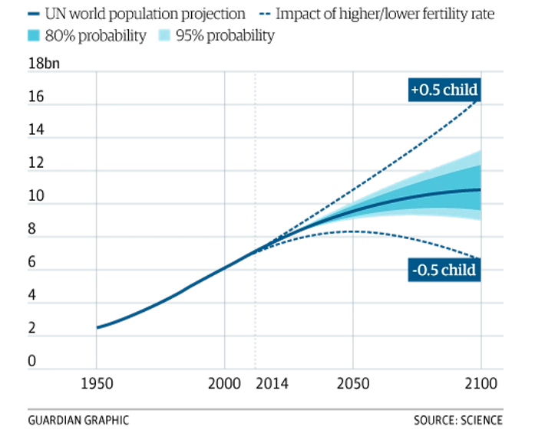
10.9bn (95%CI: 9.0 - 13.2)
50% more (CI 25-88%)
9.2bn
Gerland et al 2014 Science World population stabilization unlikely this century
11000 cities the size of Cambridge in SSA before 2050
Notes:
Our goal is to enable 9.5bn people to live well

Slide 8
Growing global income creates demand
Will the next 30 years follow the same trajectory as the last?
Tilman et al., 2011 (PNAS)

Slide 9
DRIVER 2: the global world

Slide 10

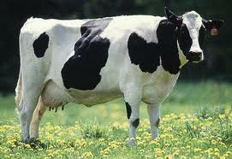
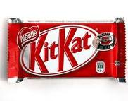
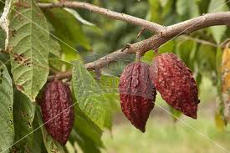
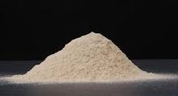
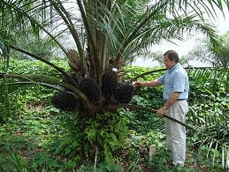
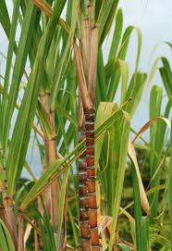
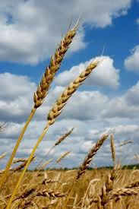
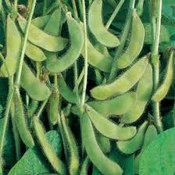
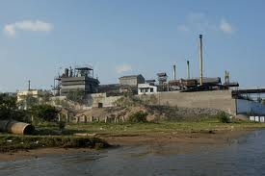
Kit kat
Milk chocolate (66%) (sugar, cocoa butter, cocoa mass, dried skimmed milk, whey powder, butterfat, vegetable fat, lactose, emulsifier (soya lecithin), flavouring), wheat flour, sugar, vegetable fat, cocoa mass, yeast, raising agent (sodium bicarbonate), salt, calcium sulphate, flavouring

Slide 11
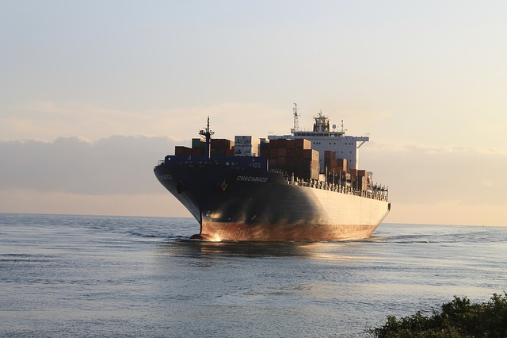
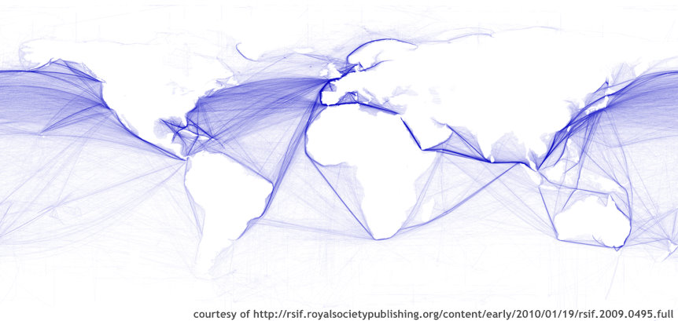
Supply chain logistics: risks and resilience

Slide 12
Evan Fraser Guelph
V
What we should be eating
(Harvard's Healthy Eating Plate Model)
What we are actually producing
(According to 2011 FAO)
Milk and Milk Products
4%
Milk & Milk Products
8%
Fruits & Vegetables
49%
Meat, fish, eggs, beans
11%
Sugar
16%
Meat, fish, eggs, beans
20%
Oils &
Fats
11%
Fruits &
Vegetables
11%
Oils & Fats
3%
Cereals and
Starches
20%
Limit
Cereals and Starches
47%
WHO< 5%
Evan Fraser, Guelph, FBS analysis, 2015

Slide 13
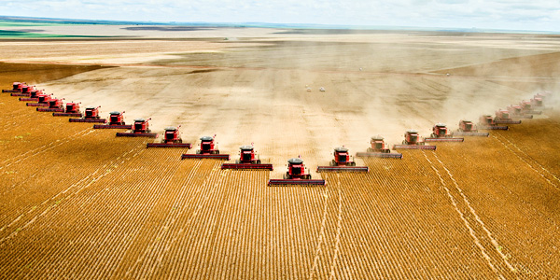
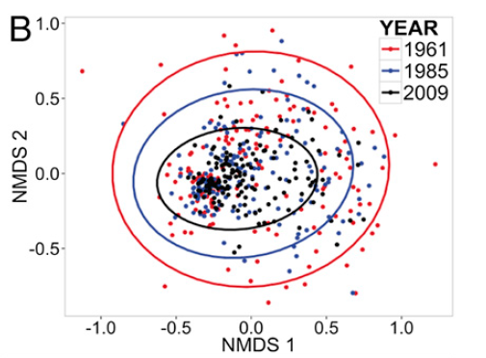
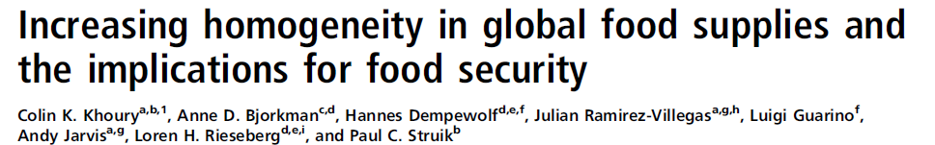
Global markets, global homogenization & cheap food
Statistical “map” of global diets
https://www.pinterest.com/fhhas/dies-das/
Nearly 2/3 of the world’s calories come from wheat, rice and maize; 86% comes from wheat, rice , maize, sugar, barley, soy, palm, potato

Slide 14
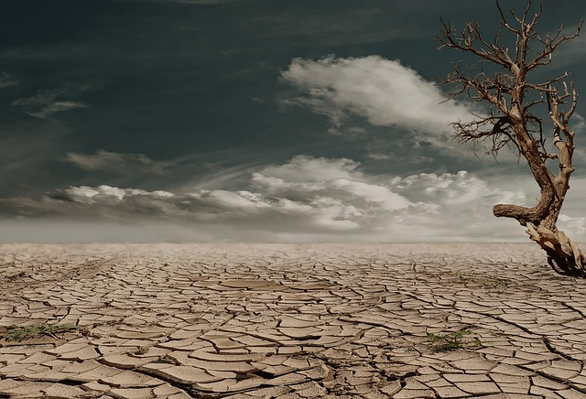
Driver 3: the world is changing

Slide 15
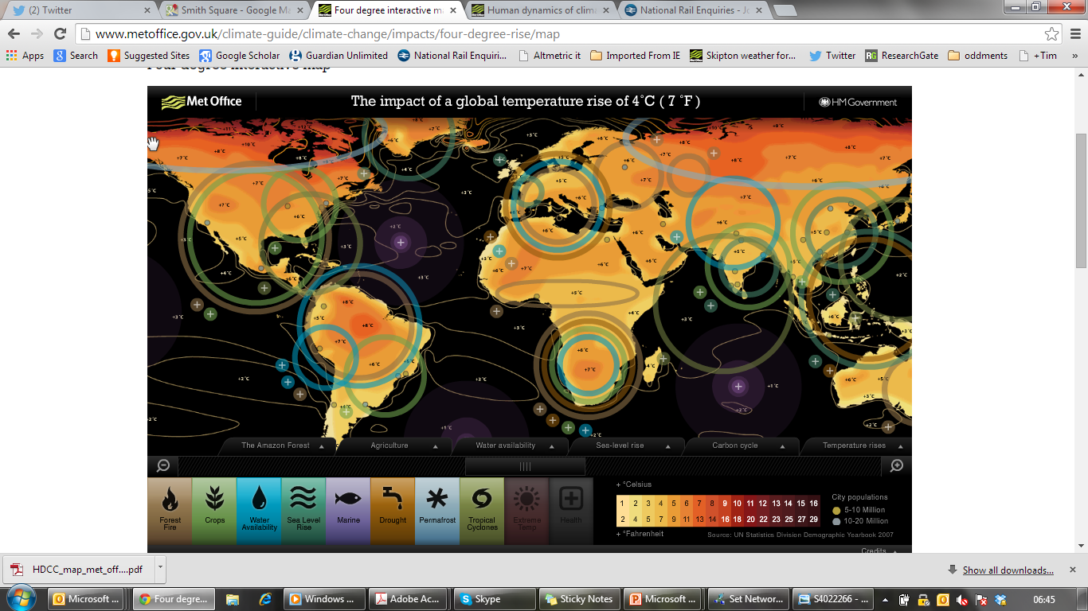
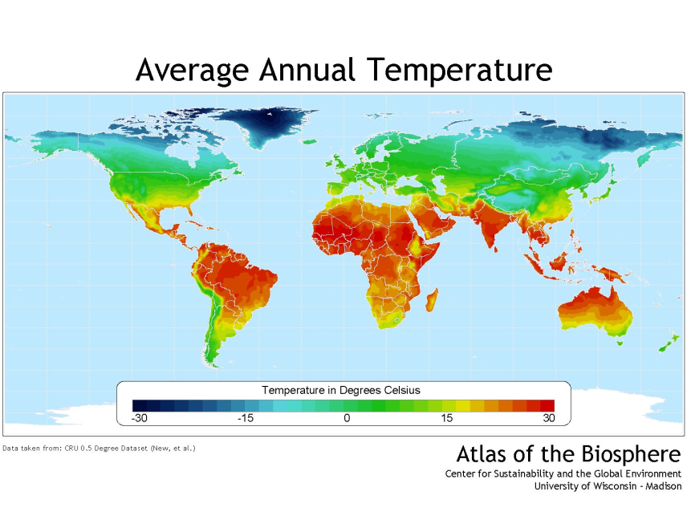
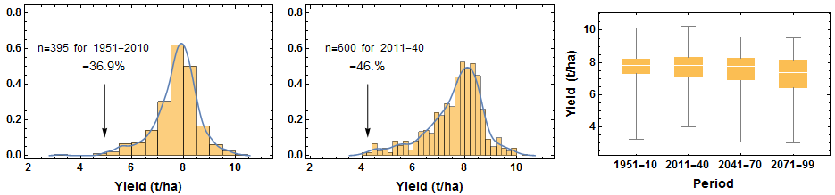

Slide 16
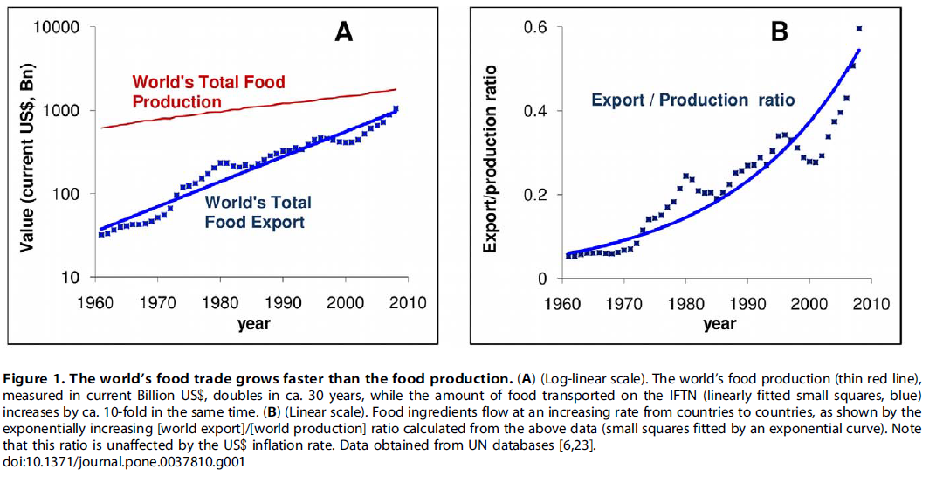

Foley et al 2011
From Wheeler & Von Braun (2013) after World Bank (2010)

Slide 17
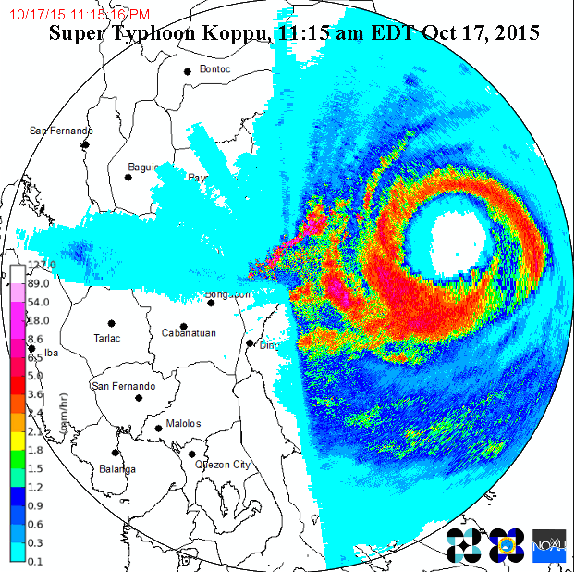
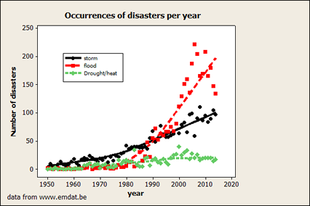
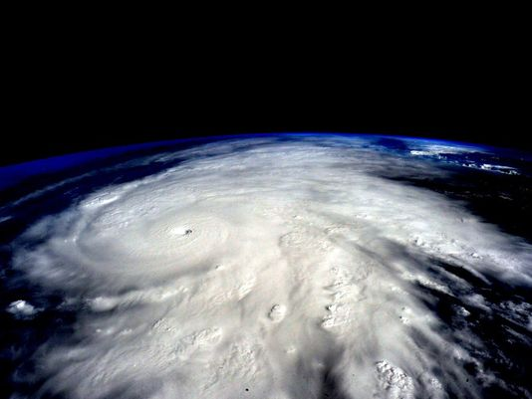
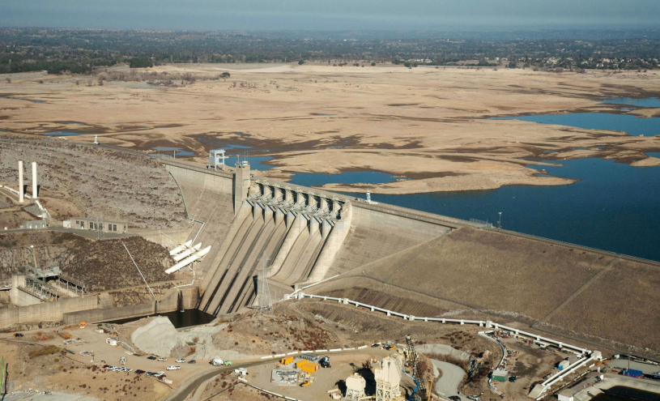
Extreme weather is getting more extreme
Patricia Oct 24 2015

Slide 18
Driver 4: Increasing competition for resources

Slide 19
Globally, there’s no more land…
Foley et al (2011) , Nature
Notes:
Essentially all land that could be used is being used (other than rain forests and deserts)
Land area for agric is more likely to shrink due to urban growth, and sea level rise (the best agric land is often near the coast)

Slide 20
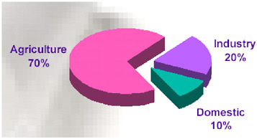
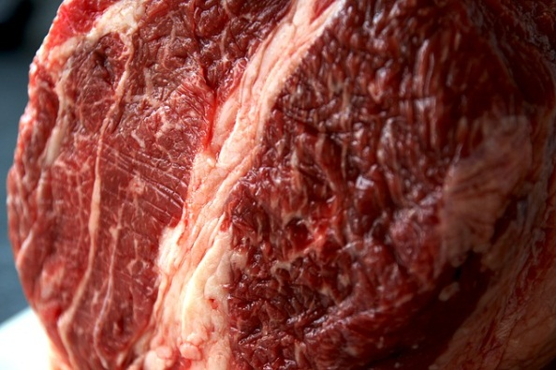
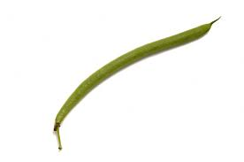
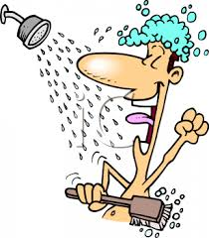
Food requires water as well as land…
Each UK person’s daily food uses:
  2231 litres rain water
  159 litres of “blue” (tap) water, 108 litres imported
  8 from top 10 UK-importing countries are “droughty”

Slide 21
DRIVER 5: health and equity

Slide 22
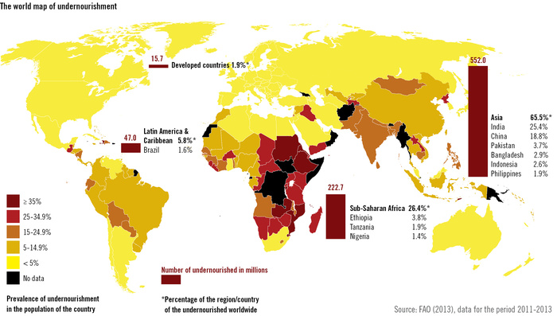
Winners and losers
Governance
Infrastructure
Lack of access to markets
Lack of education
Lack of income to invest in technology
Lack of water
AIDS/HIV

Slide 23
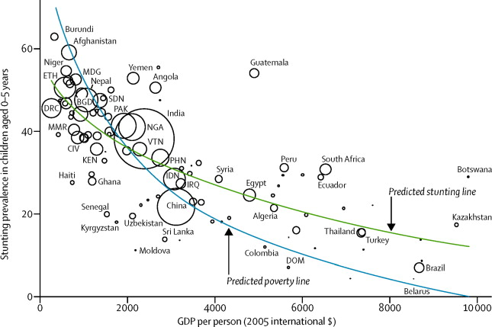
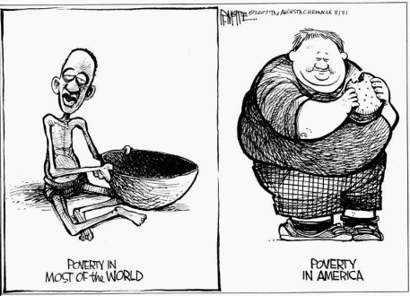
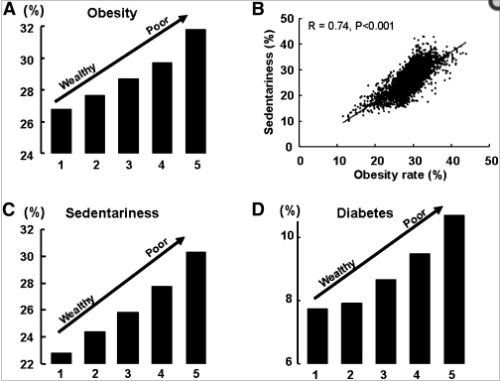

Food security and malnutrition
The Lancet 2013 382, No. 9891: 536–551
Stunting prevalence (%)
Income ($ GDP pp, 2005)

Slide 24
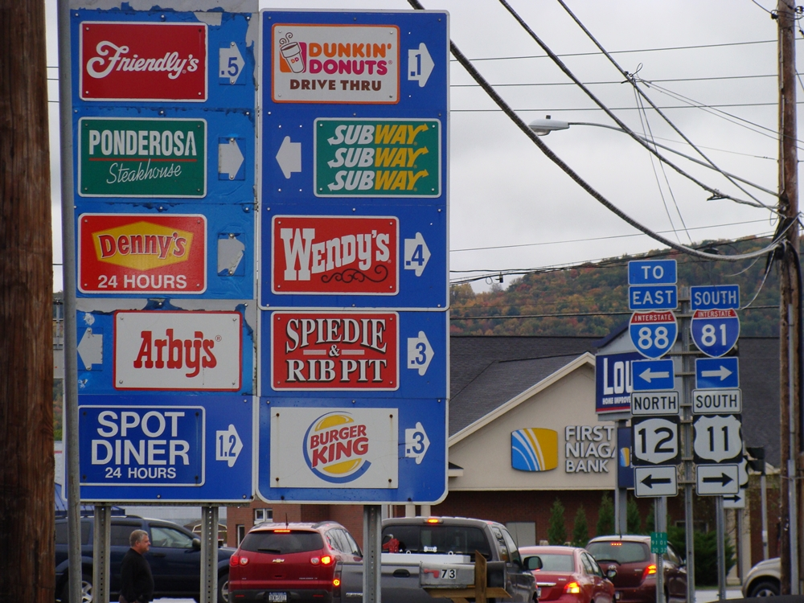
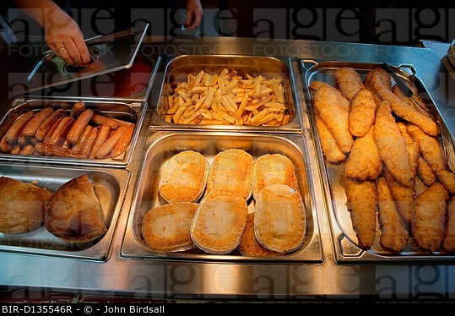

Poverty and the food environment…
If bad food is plentiful and cheap, it is difficult to avoid buying it: food deserts, food poverty, cheap calories; sometimes there’s little choice

Slide 25
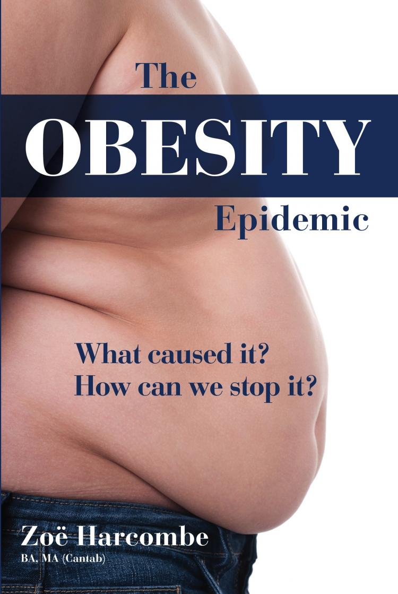
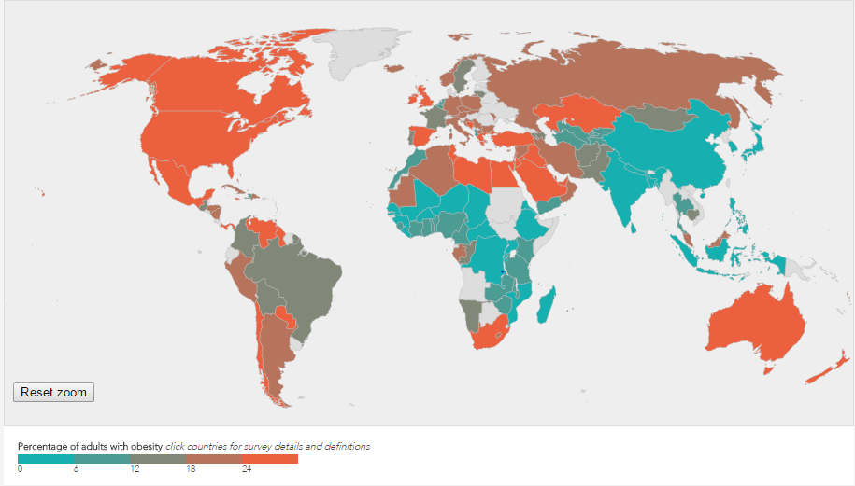
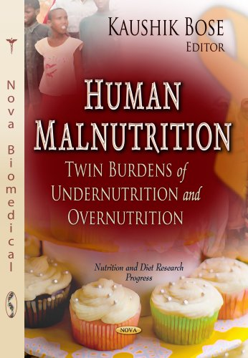


Diet, nutrition and health:
http://www.worldobesity.org/aboutobesity/world-map-obesity/?map=adults
  In 2014, more than 1.9 billion adults, 18 years and older, were overweight. Of these over 600 million were obese (WHO)
  UK Over-consumption ~20% calories
  Diabetes UK cost ~£30bn
  >50% of adult Chinese are pre-diabetic*
  over-consumption associated with >20% of deaths globally;
  Food security is “sufficient food for a healthy life”
Malnourished child by Dave Lobby via Flickr cc 2.0
*JAMA. 2013;310(9):948-958. 8
Notes:
The notion that the developed world is different in kind from the developing world is breaking down:
More people die of heart disease in the developing world now
Obesity and malnourishment occur everywhere

Slide 26
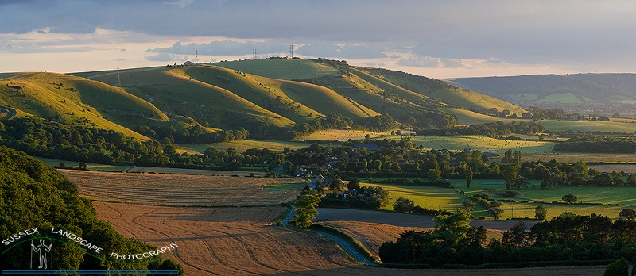
So….
More people want more food
  In the face of climate change
  And with increasing constraints on land and water
  And improve their health
Can we do it?
  And without wrecking the environment?

Slide 27
The challenges of sustainable food and nutrition security
1. Paradoxically sustainability requires intensification

Slide 28
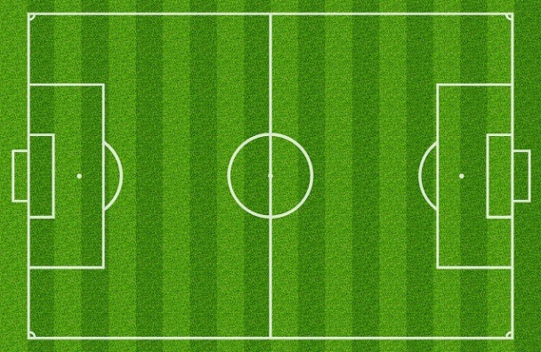
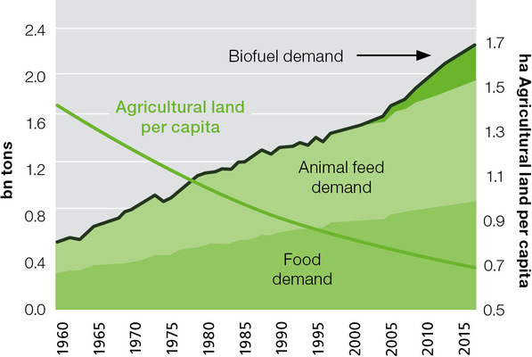

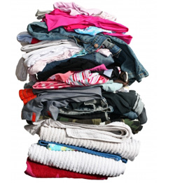
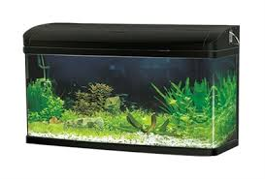

Outputs have risen per unit area to keep pace with per capita demand
Global output gone up nearly 4x
Pop size 3bn to 7bn
15 gallons
Notes:
Essentially all land that could be used is being used (other than rain forests and deserts)
Land area for agric is more likely to shrink due to urban growth, and sea level rise (the best agric land is often near the coast)

Slide 29



Improving yields via breeding, nutrition and protection
Fig 1. Time series data on wheat yields per ha for an area in Scotland, dating back to 1700. The data are the red points, with a “smoother” (a spline curve, with smoothness fitted using cross-validation) shown in black, with the standard error of the fit being shown by dotted lines). (a) shows the whole time series, (b) shows from 1940 onwards, with the smoother projected forwards to 2050. Since about 1985, the rate of annual increase in yield has declined.

Slide 30

Yield increases declining
Cassman, 1999
Grassini et al., 2011
Cassman et al., 2010

Slide 31




Natural land is under pressure
© bertrudestein on flickr via CC2
Grassini et al., 2013

Slide 32
Production shocks from weather
Yields
Recent
Mid-Cent
End-Cent
NEAR
RECENT history
Yields maintained; nutritional quality may decline
CO2 fertilisation
Yields impacted more
No CO2 fertilisation
Model-based distributions of global calorie-weighted yield of maize, soy, wheat, and rice for the historical (1951-2010) and future with (top row) and without (bottom row) the effects of fertilization from increasing atmospheric CO₂ included. The estimated magnitude of a current 1-in-200 year event is indicated by the horizontal line

Slide 33


Innovation space
Stockbridge Technology Centre’s LED Blockhouse
Efficiency of resource use, using new and best knowledge
  Best practice (perhaps especially) in low input systems
  “Precision” Farming
  Pest control
  Fertilisers and their efficiency
New genetics (crops and livestock)
Manage soils better to avoid loss of function
Efficient and innovative food storage, processing and transport
Build resilience (CSA to WTO)
Robotic weeding:
Weed recognition through machine vision (26 species); applies Glyphosphate only to the leaf of the weed (~1 g per hectare cf 720 g/ha)
Simon Blackmore, Harper Adams

Slide 34
The challenges of sustainable food and nutrition security
2. What is “sustainable”?

Slide 35


Earthrise from moon: Apollo 8 (NASA)
Brundtland Report (1987): “Sustainable development is development that meets the needs of the present without compromising the ability of future generations to meet their own needs.”

Slide 36










What does land do?
“sustainability” is about maintaining the services land provides, at a landscape scale, appropriate to context. “doing more with less” is only part of it

Slide 37



Trade-offs can complicate: need for full systems’ analysis
Spatial games: specialisation of “function” can be more efficient
amount
Parcel producing food+ biodiversity
Food ecol
Food ecol
yields
Parcel producing food
Parcel producing biodiversity
Ecology
Yield
Gabriel et al. 2009 J app Ecol; 2010 Ecol Letts; Hodgson et al 2010 Ecol. Letts

Slide 38





Market forces mean demand and supply disconnected

Slide 39



Spatial planning needed for a “sustainable system”
http://images.nationalgeographic.com/wpf/media-live/photos/000/003/cache/mt-des-voeux_300_600x450.jpg
Yield potential
Governance challenges at landscape, country and international scales
ES potential
location

Slide 40

The challenges of sustainable food and nutrition security
3. Changing demand to make space for sustainability

Slide 41










Bojana Bajzelj (2015)

Slide 42



Food loss and waste
Global food losses/waste is estimated to be 1.3 billion tonnes per annum (pa), equating to approximately one third of edible food intended for human consumption
The total food production of sub-Saharan Africa = EU+N Am food waste (230mt).
Total food waste has enough embedded calories to feed 2-3bn people
Many reasons for loss and waste:
pack size, safety, food is cheap, culture
  Need to recycle “from farm to flush”
Notes:
The notion that the developed world is different in kind from the developing world is breaking down:
More people die of heart disease in the developing world now
Obesity and malnourishment occur everywhere

Slide 43


If we carry on as we are…
We need to produce more food by 2050 than we have done in human history
This will require 120% more water; 42% more cropland and loss of 14% more forest
This will emit enough carbon dioxide to create 2 degrees of global warming
We’ll lose much of the world’s biodiversity
Food will increasingly be associated with early deaths
NCC 2014

Slide 44



Leverage point to make space for sustainability
vs.

Slide 45




Changing diets:
  Eat less
  Eat more healthily (e.g. more vegetables)
  Eat novel foods
Fried grasshoppers and bamboo worms by Alpha via Flickr cc20
© David Parry/PA

Slide 46

Business as usual is a Jevon’s paradox: more is not enough
Less waste
Healthy consumption
Low environmental impact
Managed demand
“full cost of food”
Production
(sustainable)
Sustainable nutrition
Production
(unsustainable)
Cheap food
Waste
Over consumption
Environmental impact
Increasing demand
The M25 model
(or the “economic growth increases wellbeing model”)
Notes:
The M25 paradox is that no matter how much we produce, we demand more because food gets cheaper, we get used to over consumption and we treat food as wastable …
The Pete Smith paper shows that the potential for GHG mitigtion from the food system is 4x greater by changing demand (especially for meat) than by every techno fix we can imagine in agric

Slide 47

Tim Lang: "The rich have to consume less and differently so that the poor can consume more and differently"

Slide 48

Conclusions
We can grow more food and reduce its environmental impact
There is no “magic bullet” but scope for many innovations in many areas
Unlikely we can create enough food to meet demand as it is currently projected (without significant inequality and unsustainability)
Changing demand needed to make space for sustainability
Social change therefore as important as scientific innovation
Challenges require significant research investment, important to protect budgets

Slide 49


Slide 50
Thank you!
tim.benton@foodsecurity.ac.uk
www.foodsecurity.ac.uk

Slide 51


There is no recipe for “sustainable agriculture”
High yielding organic agriculture can impact on ecology in similar ways to conventional farming
Gabriel et al 2013 J appl ecology

Slide 52

Who has the power?
Who has the power to change it?
Fig p 13 from “Environmental Balance” report by the Dutch Environmental Agency http://themasites.pbl.nl/balansvandeleefomgeving/2012/).

Slide 53
Demand for food is increasing, being driven by a growing global population and a desire to eat differently, associated with increasing global wealth and connectivity. Projections for demand imply production increasing 60-100%. Can this demand be met sustainably? In this talk, I will explore some of the issues about the scope for (and perhaps limits on) growing more sustainably. However, for the food system to provide global food security for all requires research and innovation around the whole system, including changing demand via reducing waste and eating differently.

