Slide 1
Mechanisms of absorption of iron from dietary nano iron oxides
Mohamad F Aslam,
MRC Human Nutrition Research
3rd Year PhD student, Hughes Hall College
mfa34@cam.ac.uk
16/06/2014
CSAR Meeting, Easter Term, Churchill College

Slide 2
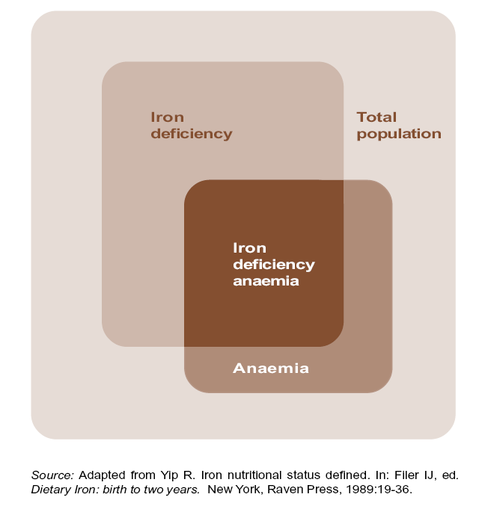
Iron deficiency anaemia (IDA)
Worldwide anaemia affects an estimate of 2 billion people.
More than 50% of these cases are due to iron deficiency.
WHO Top-10 list of global causes of morbidity and mortality

Slide 3
Iron supplementation
Current therapies for IDA involve dietary supplementation with oral iron preparations based on:
    Fe(II) salts (ferrous sulphate, ferrous gluconate, ferrous fumarate)
      Advantages: Inexpensive, Bioavailable
      Disadvantages: Significant upper and lower gastrointestinal side effects
    Complex forms of Fe(II) or Fe(III) (Fe(II)-bisglycinate, Fe(III)-trimaltol, Fe(III)-EDTA)
      Advantages: Bioavailable, reduced gastrointestinal side effects
      Disadvantages: Expensive
Aim: Identify an inexpensive, and efficacious oral iron supplement that is free of adverse-effects.

Slide 4
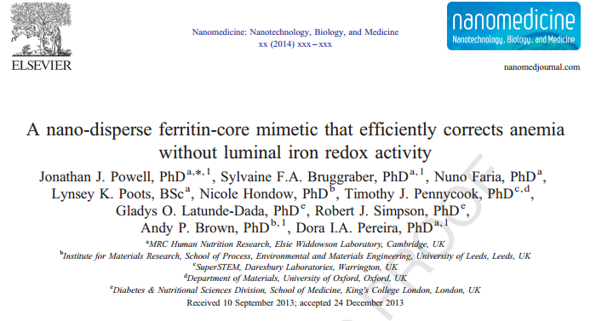
Nano Fe (III)
        Bioavailable
        Safe (no redox activity)
        Inexpensive

Slide 5
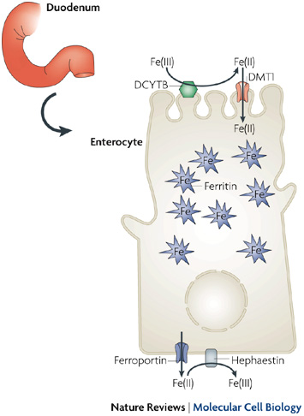
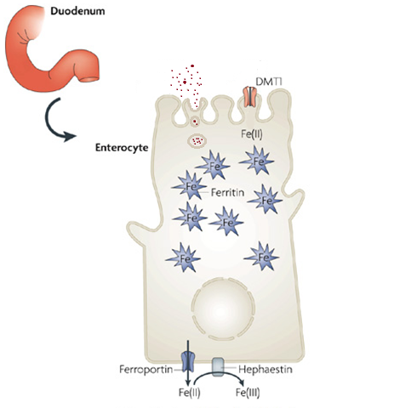
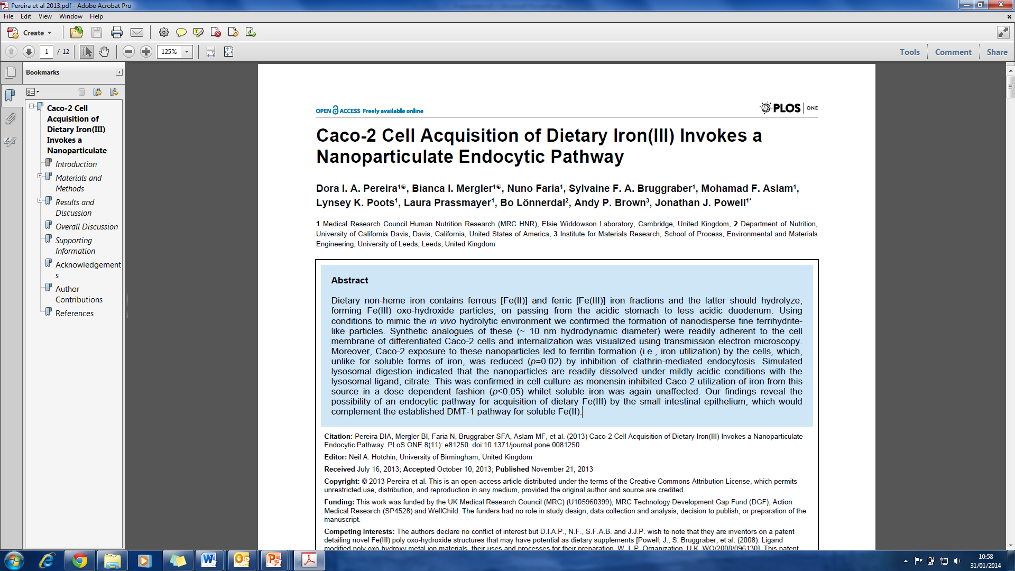
Mechanisms of iron absorption
Nano Fe (III)
?
Key question: How does iron derived from Nano Fe (III) leave the duodenal enterocyte?
Adapted from: Hentze et al. Cell, 2004. 117(3): p. 285-297.
Notes:
Add ref

Slide 6

Mechanisms of iron efflux from enterocytes
Intestinal specific Ferroportin knockout model (Fpn KO mice)
Adapted from: Hentze et al. Cell, 2004. 117(3): p. 285-297.

Slide 7
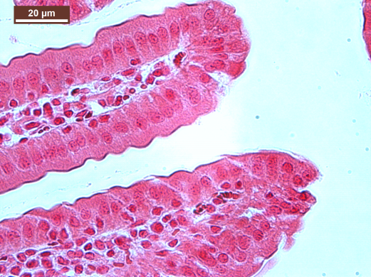
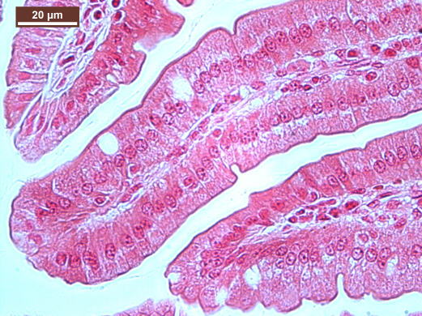
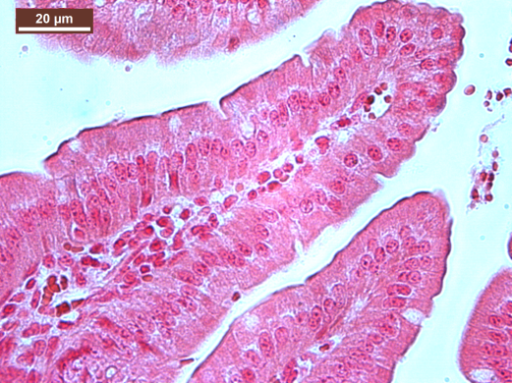
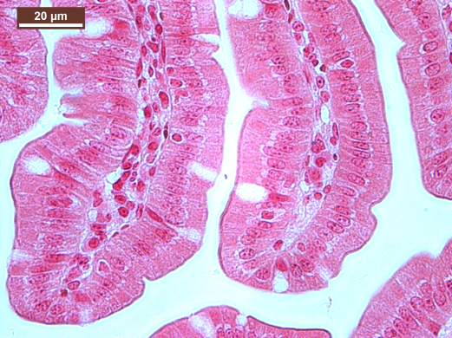
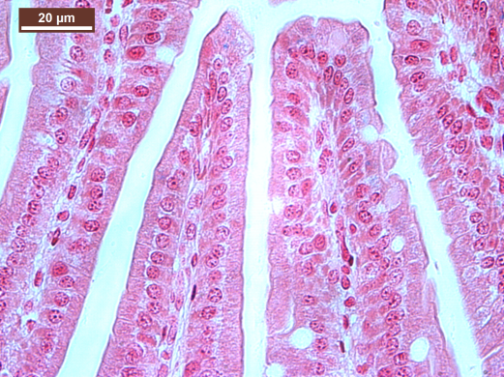
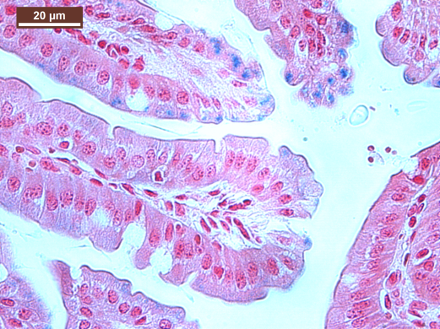
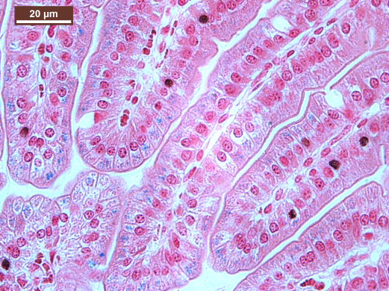
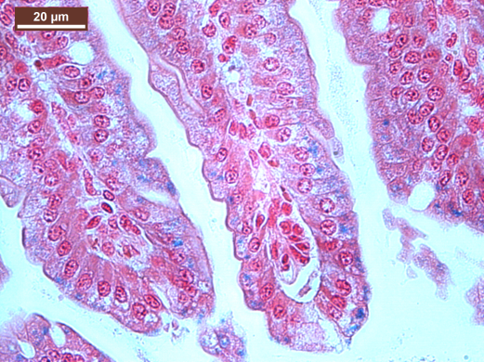
Duodenal enterocyte iron stain
Fe deficient
Control Fe sufficient
FeSO₄
Nano Fe (III)
WT
Fpn KO

Slide 8
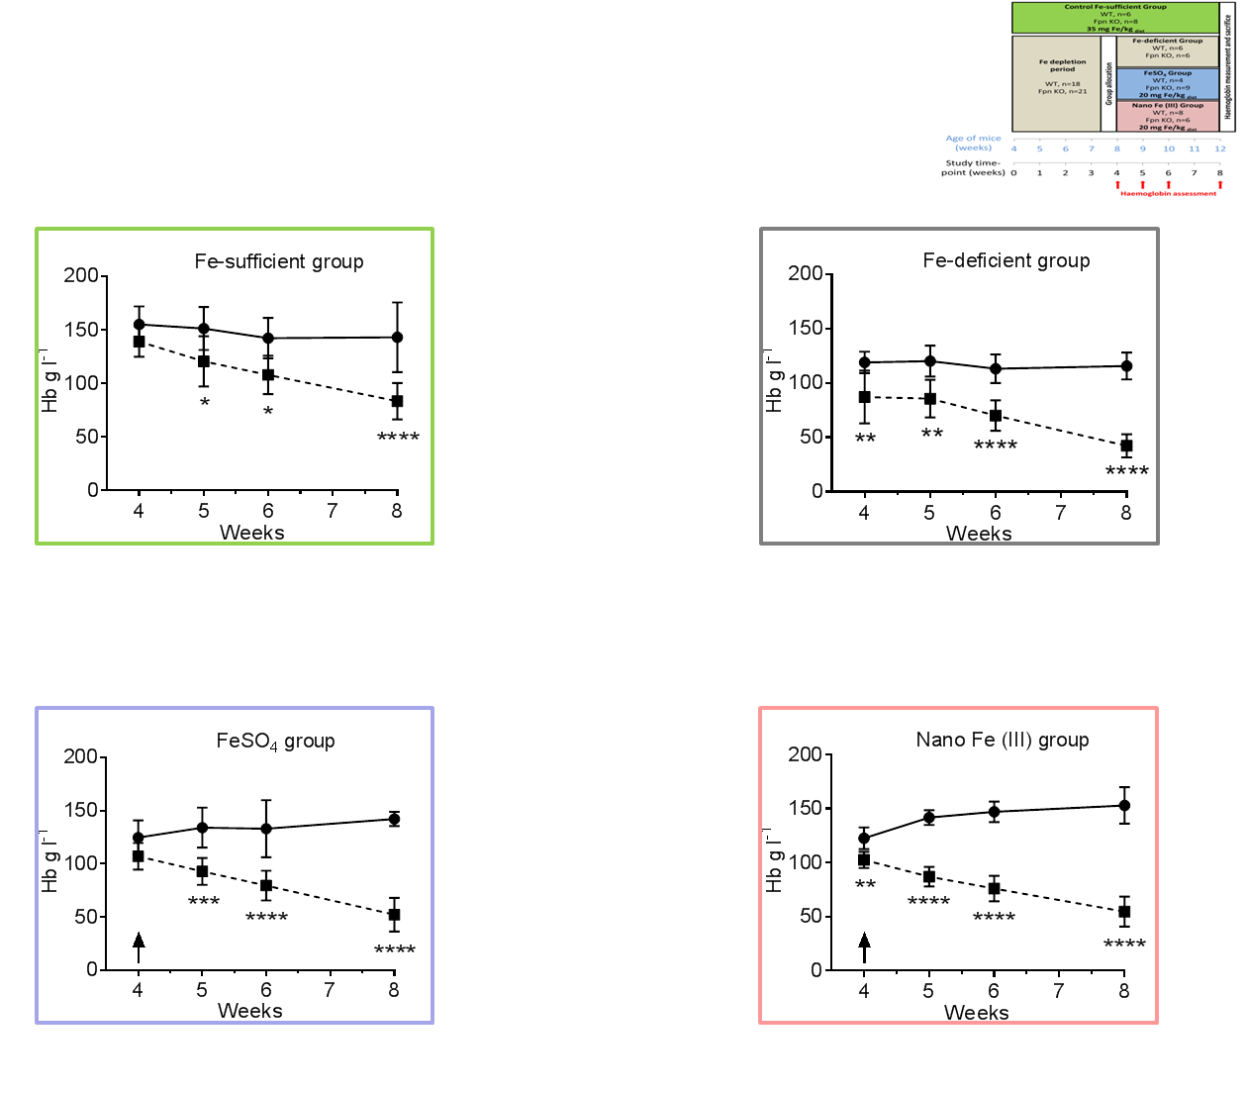
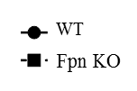
Fpn KO study

Slide 9
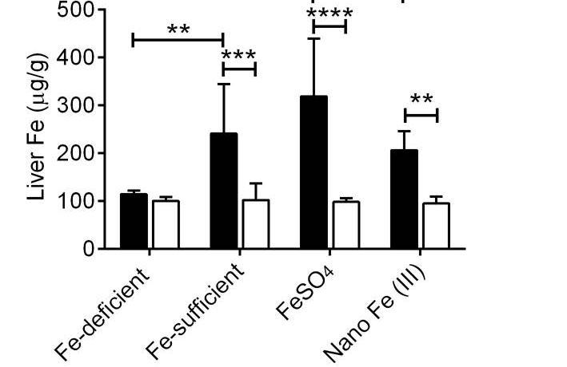
Hepatic Iron

Slide 10
Conclusion
Intestinal efflux of iron derived from Nano Fe (III) is Ferroportin mediated.
Iron derived from Nano Fe(III) does not circumvent systemic iron regulatory mechanisms
        Bioavailable
        Safe (no redox activity)
        Inexpensive
        Mechanisms of absorption

Slide 11
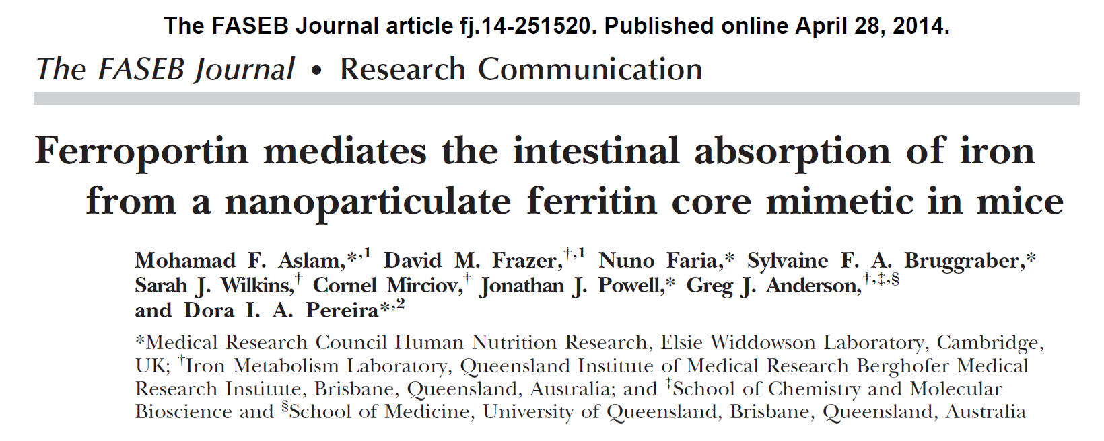

Slide 12


Thank you
Dr Dora Pereira (Supervisor)
Dr Jonathan Powell (Head of Group)
BioMineral Research Group
Professor Gregory Anderson
Dr David Frazer
Funding
mfa34@cam.ac.uk

